Slide 1
Global value chains and Japan-Brazil FTA for XVIII JBECC
August 31, 2015
Michitaka Nakatomi
President
Nippon Amazon Aluminium Co., Ltd.

Slide 2
I. GVCs and International Trade
・Global value chains (GVCs) and international trade
In 21st century, “2nd unbundling” of production process is rapidly taking place reflecting the drop in transmission cost based on ICT revolution.
Global production sharing and “fragmentation” of production process are getting common. (1st unbundling =trade cost related=20th century, 2nd unbundling =transmission cost related=21st century)
See Baldwin(2012)
・The development of GVCs is regionally very skewed.
There are only 3 regions where GVCs are highly developed.
They are North America, Europe and East Asia.
GVCs are not yet developed in South America and Africa.
See IADB(2014), Mckinsey(2014), WEF(2013), R. Baldwin(2012)

Slide 3
I. GVCs and International Trade
・To foster GVCs and involve a country in it requires business environment and connectivity of goods, services, money, knowledge as well as man-to-man connectivity. See WEF(2013)
・Connectivity in Asia is being rapidly developed around three pillars:
Physical infrastructure, institutional infrastructure(e.g. legal system such as Free
Trade Agreement, trade facilitation ) and man to man connectivity.
Japan is deeply involved in fostering these 3 pillars in Asia.
・Asian model and Japan’s efforts in Asia are applicable to Brazil in many aspects to involve Brazil in GVCs. Above all, Free Trade Agreement with Japan can be the basis for linking Brazil with Asian and global value chains.

Slide 4
I. GVCs and International Trade
・ Japan itself has changed its role in GVCs rapidly.
・Japan has developed sophisticated value chain network in Asia.
・ In manufacturing, the share of intermediate goods and services
content in manufactured exports are increasing (=servification).
・The share of services exports is increasing.
See IDE/JETRO andWTO

Slide 5
Developing Value Chain Network in East Asia (1)
Intermediate Goods
70%～
60%～
50%～
40%～
30%～
～30%
(Source) RIETI-TID 2011
(billion US Dollar)

Slide 6
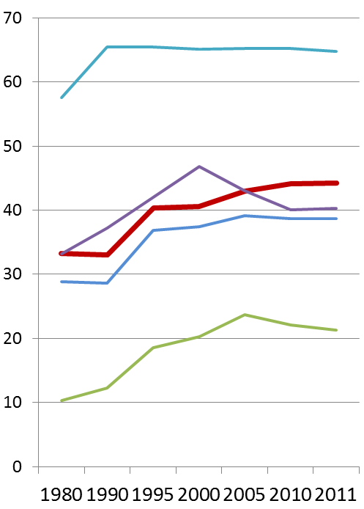
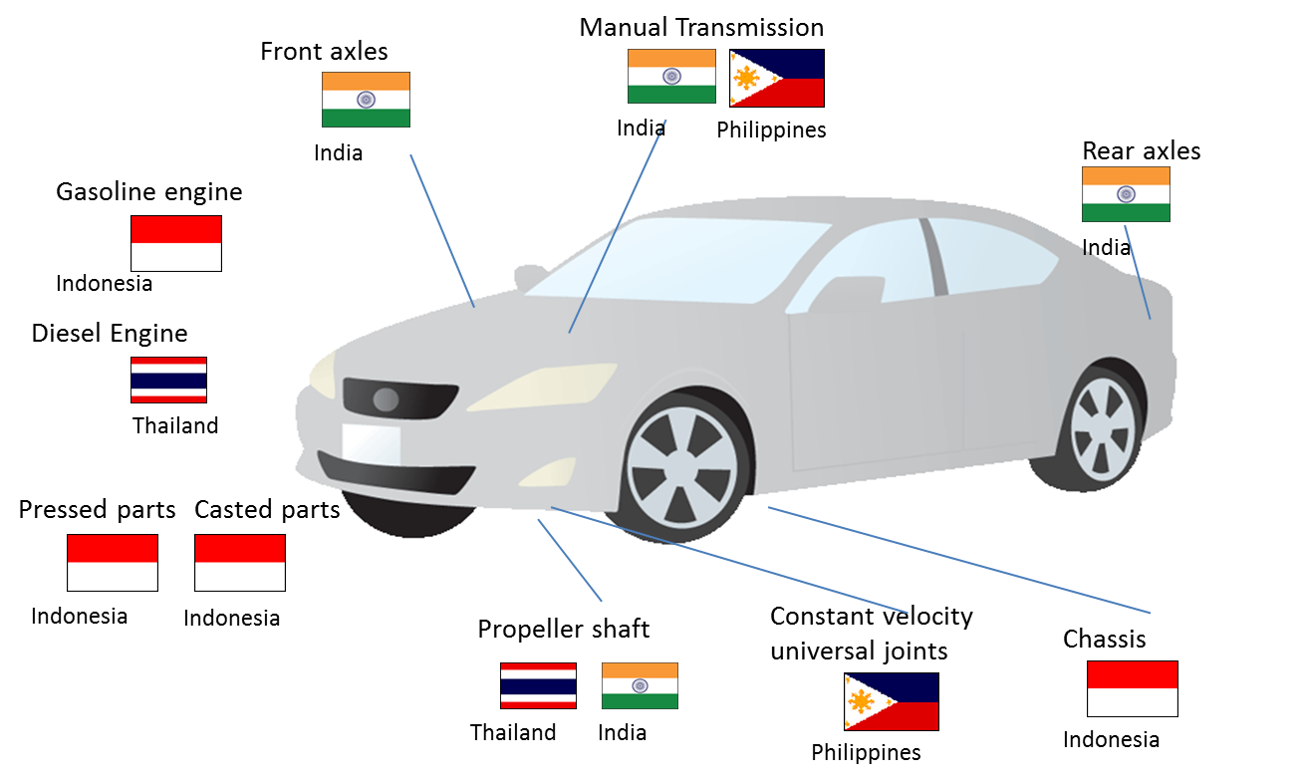
Developing Value Chain Network in East Asia (2)
Example of production network for auto parts
Intra-regional trade in ASEAN+6
now exceeds NAFTA
(%)
EU
ASEAN+6
NAFTA
ASEAN+3
CJK
Wire Harness
Cambodia
Source: JETRO 2012

Slide 7
Development of Japan’s EPA/FTA Network
In force/Signed ( 12 countries and 1 region )
Asia | Singapore | Asia | Vietnam
 | Malaysia |  | India
 | Thailand | Latin America | Mexico
 | Indonesia |  | Chile
 | Brunei |  | Peru
 | ASEAN | Europe | Switzerland
 | Philippines
In force/Signed
Under Negotiation
Joint Study
Japan-EU EPA
China-Japan-Korea FTA
TPP
( Trans-Pacific Partnership )
Under Negotiation ( 5 countries and 5 regions )
Asia | Mongolia | Pacific | Australia
 | C-J-K | Europe | EU
 | RCEP | North America | Canada
 | Republic of Korea (Negotiation suspended ) | Latin America | Colombia
Asia/ Pacific | TPP | Middle East | GCC*
RCEP
( Regional Comprehensive Economic Partnership )
( ASEAN, Japan, China, Korea, India, NZ and Aus )
Joint Study ( 1 country )
Middle East | Turkey
* GCC: Gulf Cooperation Council (UAE, Bahrain, Kuwait, Oman, Qatar, Saudi Arabia)

Slide 8
Development of Regional FTA/EPAs in East Asia
After completion of ASEAN+1s and proposals of +3 (EAFTA) and +6 (CEPEA), negotiation of RCEP (Regional Comprehensive Economic Partnership) began. Japan-China-Korea FTA is also developing simultaneously.
TPP negotiation has been strongly affecting. Some ASEAN member countries participate in TPP
ASEAN
ASEAN+1
ASEAN++
Outside
EAFTA
ASEAN+3
CEPEA
ASEAN+6
CEPT under AFTA
(1993)
ASEAN China FTA (goods) (2005)
ASEAN Korea FTA (goods) (2007)
AJCEP (goods) (2008)
ASEAN Australia-New Zealand FTA (2010)
ASEAN India FTA (goods) (2010)
China proposed ASEAN+3 (2003)
Discussion on FTAAP
(2006～)
Japan proposed ASEAN+6 (2006)
2006
ATIGA (ASEAN Trade In Goods Agreement)
(2008)
Track 2 study
Track 2 study
Agreed to launch governmental discussion with CEPEA and EAFTA in parallel (2009 EAS)
TPP negotiation
(2010～)
2009
Japan and China jointly proposed WG for liberalization (2011)
Japan China Korea agreed to prepare for FTA (2011.5)
Completion of ASEAN+1 FTAs with 6 partners
ASEAN proposed RCEP (2011.12)
2011
Japan-China-Korea FTA announce(2012) launch (2013)
Tariff Elimination of all ASEAN members by 2015
Announced to launch RCEP negotiation in early 2013 (2012 EAS）
Launch of RCEP negotiation (2013)

Slide 9
2. GVCs and Japan-Brazil relationship
・Global value chains (GVCs) and trade rules
GVCs require multifaceted rules covering not only border measures but
behind-the-border measures/non tariff issues.
Holistic coverage of trade rules is essential.
・FTA and GVCs
WTO headed by DG R. Azevedo is ideally the best forum to develop
global rules related to GVCs but the Doha Round logjam is serious.
Deep FTA is, for the time being, the most promising option to
realize liberalization and rulemaking to meet the needs of GVCs.

Slide 10
2. GVCs and Japan-Brazil relationship
・Japan-Brazil FTA
Developing FTA between Japan and Brazil matching the needs of
business societies and GVCs is a realistic choice.
・JBECC recommendation for the comprehensive Japan-Brazil FTA is thus most relevant.

Slide 11
2. GVCs and Japan-Brazil relationship
・Basic points for consideration on Japan Brazil FTA from GVC perspectives
・Think always Supply Chain implicationーAccomodating the interests
of businesses and realities of GVCs
See WEF(2013)
・Think Globally—Necessity of vision on future global trade system
To form the basis of future WTO rules, not just regional rules.
Avoiding emergence of “Spaghetti bowls in rules” is essntial.
See WEF(2013), Keidanren(2013) (Concept of “Unified Axis”),
Nakatomi(2013), Baldwin and Nakatomi (2015)
・Think “Holistic” approach

Slide 12
2. GVCs and Japan-Brazil relationship
・Avoid hegemonic fights
Japan as a non hegemon (currently trying to bridge Asia, Europe
and Americas by the network of FTAs) is the perfect partner for
Brazil to begin developing mega FTA.
・Speed and flexibilityーsince the shape of GVCs is changing all the
time
Quick launch and conclusion of the negotiation and flexible
adaptation/adjustment machanism after implementation is
required.

Slide 13
References
Baldwin, Richard (2012), “WTO 2.0: Global Governance of Supply-Chain Trade,” CEPR Policy Insight 64.
Baldwin,Richard and Michitaka Nakatomi (2015). ”A world without the WTO: what’s at stake?,” CEPR Policy Insight No 84(July 2015), Centre for Economic Policy Research
IADB (2014), “Synchronized Factories Latin America and the Caribbean in the Era of Global Value Chains”
IDE/JETRO and WTO (2011), “Trade Patterns and Global Value Chains in East Asia: From Trade in Goods to Trade in Tasks”
Keidanren (2013), “Proposals for Redefining of Trade Strategy: Towards a proactive new trade strategy that takes the initiative to establish global rules,” April 16, 2013.
McKinsey Global Institute (2014), “Connecting Brazil to the world: A path to inclusive growth”
Nakatomi, M. (2013), “Global Value Chain Governance in the Era of Mega FTAs and a Proposal of an International Supply-chain Agreement,” VoxEU Column, August 15, 2013.
World Economic Forum(2013), “Enabling Trade: Valuing Growth Opportunities”

