Slide 1


Slide 2

BUSINESS COOPERATION AND INVESTMENT OPPORTUNITIES
IN THE INFORMATION TECHNOLOGY SECTOR
José Antonio Antonioni
Director President
jaa@softsul.org.br

Slide 3


Slide 4
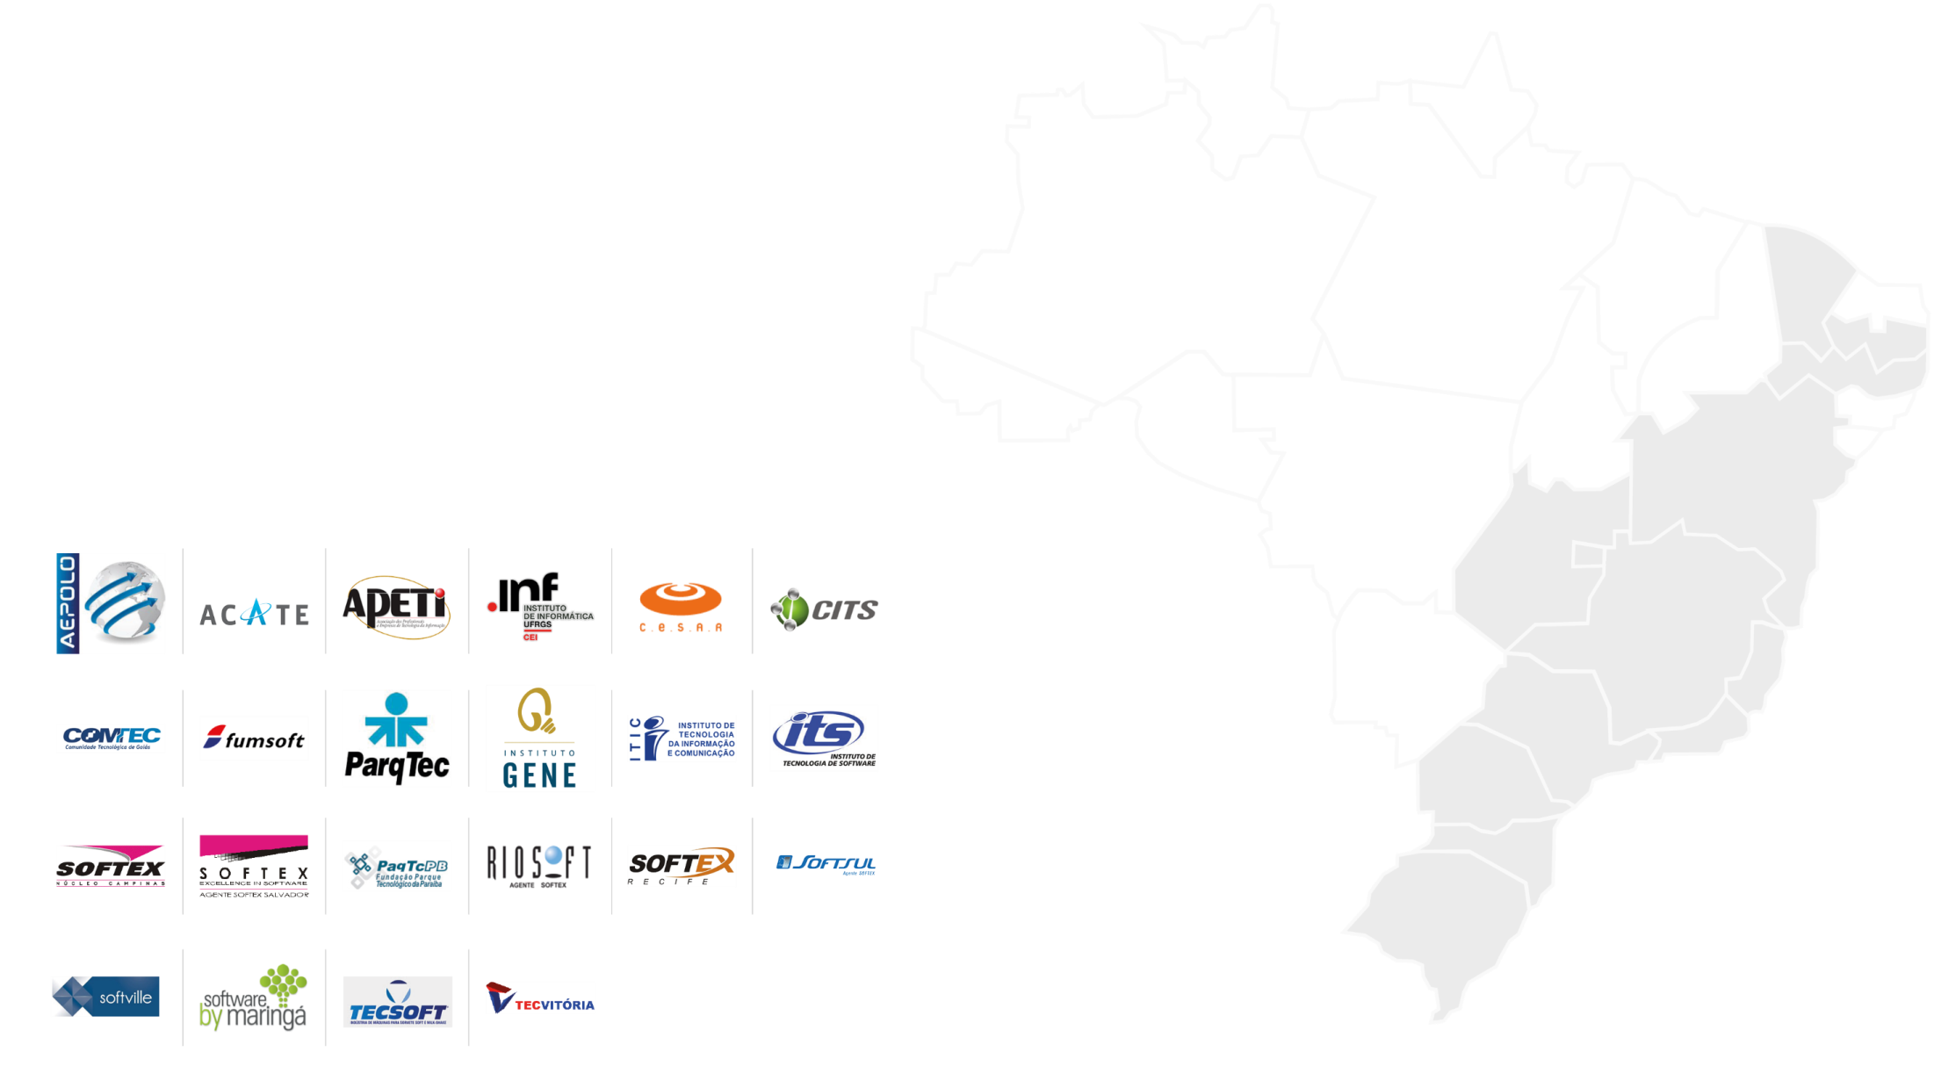
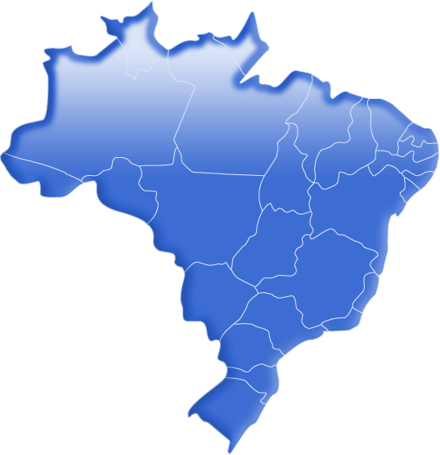
22
Fortaleza
REGIONAL AGENCIES
Campina Grande
Recife
Salvador
Goiânia
Brasília
Belo Horizonte
Vitória
S. J. Rio Preto
São Carlos
Rio de Janeiro
Campinas
Maringá
São Paulo
Curitiba
Blumenau
Joinville
Caxias do Sul
Florianópolis
Porto Alegre

Slide 5



+ 2000
IMPACTED COMPANIES

Slide 6







Action areas
^{Market Intelligence}
Training of companies and people
^{Innovation Strategy}
Encouraging the entrepreneurship and supporting to startups
^{Support the access to funding}
Encouragement and support the internationalization of companies

Slide 7
Encouragement and support the internationalization of companies

Slide 8
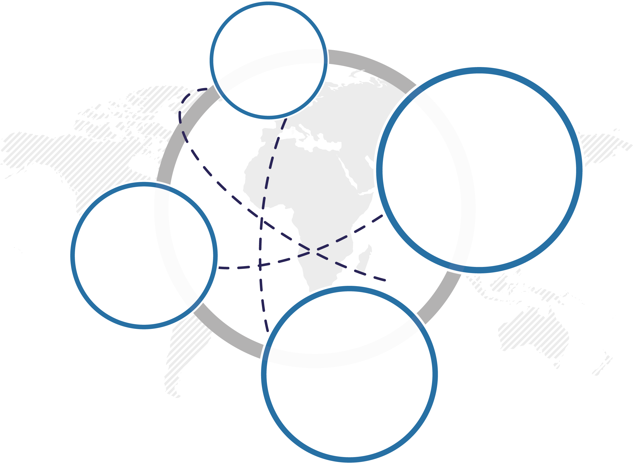



Encouragement and support the internationalization of companies
94
Promotion actions
USD
930MI
Exported volume
between 2012 and 2013
by participating companies
Sectorial Project for the Promotion of Exports
Some results
269
adhering
companies
US$
594MI
Exported in 2014 by companies participating in the PS-SW

Slide 9
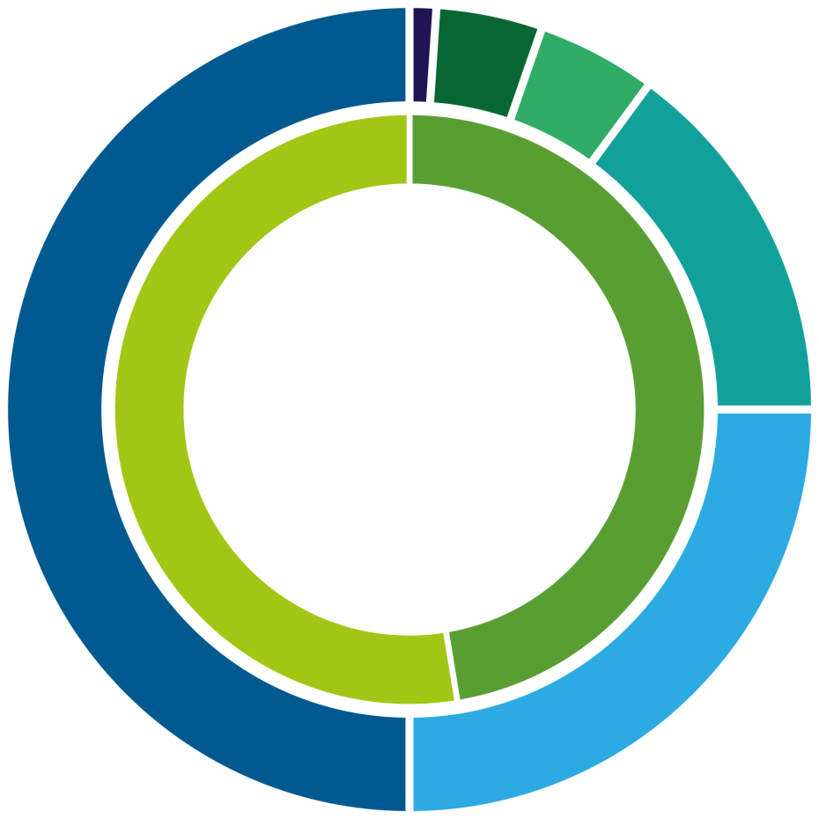
Encouragement and support the internationalization of companies
2
Image actions
8
International missions
9
Selling projects
28
Buyer projects
Sectorial Project for the Promotion of Exports
35,5%
Increase compared to 2012
29,3%
Above the set target
47
International fairs
94
Comercial
promotional actions

Slide 10
Some data
of the Brazilian IT market (*)
Brazilian IT market: US $ 61 billion, 7th place in the world’s ranking Software and IT Services: US$ 25,2 billion
Represents: 46% of the Latin American IT market (US $ 128 billion) and 3% of total world market (US $ 2.09 trillion).
Growth in 2014: 6.7% (Expected growth in 2015 is around 5%)
Number of smartphones in use in Brazil: 154 million (2014)
Number of computers installed in Brazil: 69.9 million last year
Internet connected users: 120 millions
Projection: 45% of IT investments in Brazil in 2015 will be on tablets, smartphones and computers.
(*) Source IDC/ABES

Slide 11
Regional distribution of the Brazilian IT market
Region | Percentage
Southeast | 60,67%
South | 14,53%
Midwest | 10,9%
Northeast | 10,1%
North | 3,7%

Slide 12
Profile of software and IT services companies in Brazil
Led by micro and small companies
Micro: 45,62%
Small: 49,02%
Medium: 4,33%
Big: 1,03%.

Slide 13
Brazilian Industry of Software and IT Services (BISS)
54,8
62,1
73,3
77,0
81,8
Number of companies (Thousand)
5.9%
27,4
Net revenue (US$ Billion)
8.0%
Number of employed people (Thousand - in Dec. 31)
379
434
512
597
644
7.9%
Number of salaried people (Thousand in Dec. 31/12)
290
350
407
493
538
9.3%
2007 2009 2011 2013 2014
CAGR. 2007-12
Estimate
Source: Softex, from PAS/IBGE.

Slide 14
BISS: 20 or more employed people
Number of companies
2014: 3,818 companies
Net revenue
Companies are very small
Revenue concentrated in large companies

Slide 15
Brazilian Foreign Trade in
Services Balance US$ Billion
 | 2013 | 2014 | ∆% 2014/2013
Exports | 37,5 | 39,8 | 6,3%
Imports | 83,2 | 87,0 | 4,6%
Deficit | -45,7 | -47,2 | 3,3%
Tradeflow | 120,7 | 126,9 | 5,1%
Source: SISCOSERV – Period Jan. 01, 2014 to Dec. 31, 2014. Apud in Serviços: panorama do comércio internacional – 2014. SCS/MDIC.

Slide 16
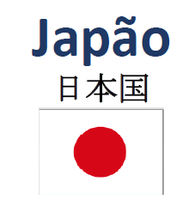
Japan
Profile of bilateral trade in services
Brazil and Japan - 2014
Brazil´s sales (US$ Thousand) | 843,541
Purchases by Brazil (US$ Thousand) | 870,737
Brazilian balance (US$ Thousand) | -27,196
Brazil
Sellers in Brazil | 1,740
Acquirers in Brazil | 1,219
Trade of services (US$ Thousand) | 1,714,278
Source: SISCOSERV – Period Jan. 01, 2014 to Dec. 31, 2014. Apud in Serviços: panorama do comércio internacional – 2014. SCS/MDIC.

Slide 17
Exports from Brazil to Japan – 2014
Ten major items of exports
US$ Thousand: 843,541
Software and IT services are not part of the main items of exports
Japan
ITEM | %
Activities auxiliary to financial services, except insurance and pension funding | 24.01%
Financial service activities, except investment banking, insurance and pension funding | 17.59%
Activities of head offices; management consultancy activities | 10.30%
Office administrative, office support and other business support activities | 8.68%
Suport services for water transport | 7.00%
Services of merchandise distribution | 6.06%
Services of water transport of loads | 3.33%
Other support services | 3.17%
Cargo handling services | 2.91%
Legal services | 2.90%
Brazil
Source: SISCOSERV – Period Jan. 01, 2014 to Dec. 31, 2014. Apud in Serviços: panorama do comércio internacional – 2014. SCS/MDIC.

Slide 18
Brazilian imports from Japan – 2014
Ten major items of imports
US$ Thousand: 870,737
Software and IT services are not part of the main items of imports
Japan
ITEM | %
Technology transfer agreements | 28.21%
Financial service activities, except investment banking, insurance and pension funding | 17.26%
Services of water transport of loads | 11.59%
Operating lease or rental of machinery and equipment without operator | 8.33%
Office administrative, office support and other business support activities | 4.74%
Reinsurance services | 3.36%
Other supporting transport services | 3.05%
Assignment of rights on industrial property | 2.31%
Licensing rights on industrial property | 2.22%
Engineering services | 1,74%
Brazil
Source: SISCOSERV – Period Jan. 01, 2014 to Dec. 31, 2014. Apud in Serviços: panorama do comércio internacional – 2014. SCS/MDIC.

Slide 19
Software and IT services: exports from Brazilian companies – 2014
Brazil
Considering presence among the top tem items (R10) of exports
DESTINATION | US$ (in Thousand)
United States | 247,080
Netherlands | 90,225
United Kingdom | 62,046
Mexico | 26,127
India | 18,643
Chile | 13,496
Colombia | 8,717
Canada | 8,178
Argentina | 6,029
Peru | 4,851
Venezuela | 4,834
Panama | 3,151
Australia | 2,331
Equador | 2,053
Paraguai | 1,805
Bolivia | 927
 | 500,494
Low presence of Brazilian software and IT services in the exports to Asian countries.
Brazilian software and IT services exports still restricted to the American continent and the European Union.
Source: SISCOSERV – Period Jan. 01, 2014 to Dec. 31, 2014. Apud in Serviços: panorama do comércio internacional – 2014. SCS/MDIC.

Slide 20
Software and IT services: imports to Brazil – 2014
Brazil
Considering presence among the top tem items (R10) of imports
Low presence of Asian countries (the exception is South Korea).
Dominated by American and European Union sellers.
SELLER | US$ (in thousand)
Germany | 239,064
Netherlands | 68,829
South Korea | 24,142
Canada | 21,170
Mexico | 16,454
Argentina | 12,514
India | 11,990
Uruguay | 7,842
Colombia | 3,215
Australia | 2,058
Peru | 1,651
South Africa | 1,627
TOTAL | 410,555
Source: SISCOSERV – Period Jan. 01, 2014 to Dec. 31, 2014. Apud in Serviços: panorama do comércio internacional – 2014. SCS/MDIC.

Slide 21
Areas where there are opportunities for cooperation / partnership in IT
Verticals (Digital Ecosystems)
Education
Health
Oil and Gas
Energy
Aerospace / Aeronautical
Agriculture and Environment
Finances
Telecommunications
Mining
Strategic technologies
Cloud Computing
IT Security
Business Intelligence
Big Data
Analytics
Mobility, Internet
Digital Games
High-Performance Computing – HPC
Internet of Things (IoT)

Slide 22
Successful cases
Successful cases of cooperation between Brazilian and Japanese companies as part of the Softex programs
2001: Malisoft Technologies was contracted to develop Taylor solutions by the Japanises Brastech and IWI
2002: Malisoft Technologies was contracted to develop the web digital journal to the International Press (IPC Tokyo)
2003: Software Design (currently Matera) and Programmers, both from Campinas, to develop an application to the Japanese Brastel
2004: Malisoft Technologies was contracted to develop a management system (ERP) to the Concept (Tóquio)

Slide 23
Successful cases
Successful cases of cooperation between Brazilian and Japanese companies as part of the Softex programs (cont)
2005: EonsGames from Curitiba win the NTT DoCoMo Prize, "The best Do-Ja game in 2005". Best game developed for the Japanese market of mobile d evices in 2005, PET category.
2006: Acquisition of Politec by Mitsubishi Systems
2007: Visit of the Rococo, Osaka company to Brazil, seeking busines
2008: Development agreement between TechResult (Curitiba) and Nextscape (Tokyo)

Slide 24
Successful cases
Successful cases of cooperation between Brazilian and Japanese companies as part of the Softex programs (cont)
2009: Joint venture of Ci&T (Campinas) with Rococo (Osaka) creating Ci&T Pacific in Tokyo (May 2009). In September, Ci&T Pacific founded the Rococo Nimgbo, a software factory in China.
2010/11: The market reversed due to the global financial crisis and the earthquake in Japan. Japanese companies have pursued the Latin American market and some acquisitions happened. There was the entry of NTT Data in the Brazilian market.
2011: TOTVS (TQTVD Division, Digital TV), opens office in Tokyo to serve the TV manufacturers using middleware Ginga

Slide 25
Successful cases
Successful cases of cooperation between Brazilian and Japanese companies as part of the Softex programs (cont)
2012: Fujisoft contracts the CITS (Curitiba) to perform software testing for new Digital TV device to be launched on the market
2012: CITS is contracted to test the equipment Garapon, Tokyo, linked to the Digital TV market, aiming to adapt to the middleware Ginga
2013: Toshiba hires ERP in Brazil to serve Japanese client inaugurating new plant in the state of S Paulo.
2014/15: Movile starts studies to launch PlayKids application in China and Japan. In China was released in 12/2014 and 05/2015 in Japan.

Slide 26
On bilateral relations between Brazil and Japan
Japan
Lots to do, yet. Brazilian business in general are still very oriented to the domestic market.
Software and IT services trading between Brazil and other countries is undeveloped.
Brazil has a relevant software and IT services industry. It has a sophisticated internal market.
Japan could be a stepping stone for entry of the Brazilian software and IT services industry in Asian countries. And vice versa Brazil to the Japanese in the Latin America.
A good partnership in Brazil: Japan providing hardware (equipment in general and mobile devices and components, in particular); Brazil providing embedded software and integrated circuit design services.
Brazil

Slide 27


www.softex.br
José Antonio Antonioni
jaa@softsul.org.br

