Slide 1

DENILSON RODRIGUES DE ARAUJO, Dr. Ing., M.Sc.
GENERAL MANAGEMENT - TECHNOLOGY AND ECO-EFFICIENCY
NATURAL RESOURCES AND REWEABLE ENERGY
SOME SAMARCO’S EXPERIENCES AND CHALLENGES
PORTO ALEGRE, 31 AUGUST 2015

Slide 2

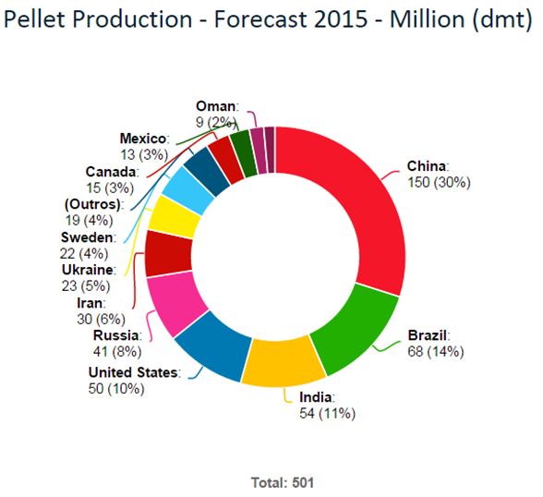
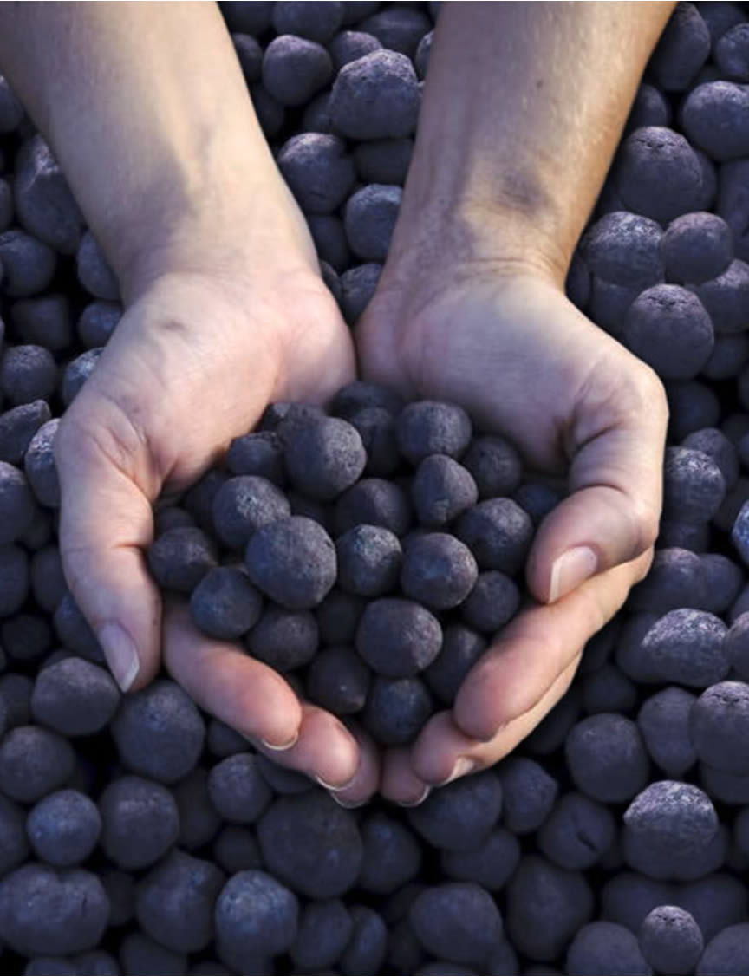
WHO WE ARE
SAMARCO
Since 1977 producing and supplying iron ore pellets to seaborne market
Total Pellet Production = 501 million ton (E)
Seaborne Market = 114.8 million ton (2014) ⬄ 22,8%
Samarco Market Share = 25 million (2014) ⬄ 21%

Slide 3
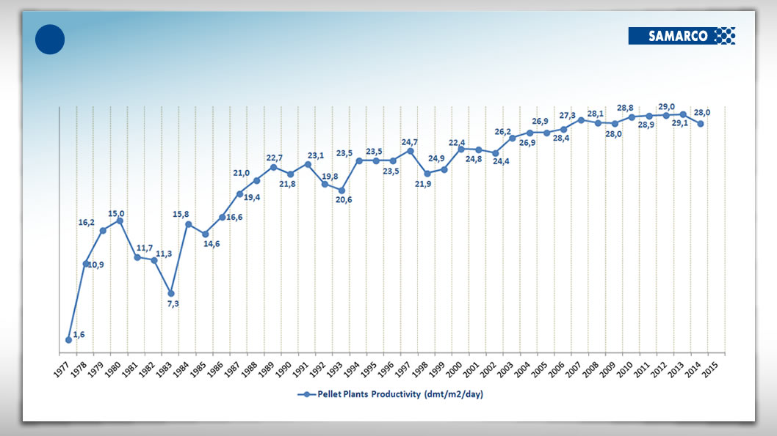
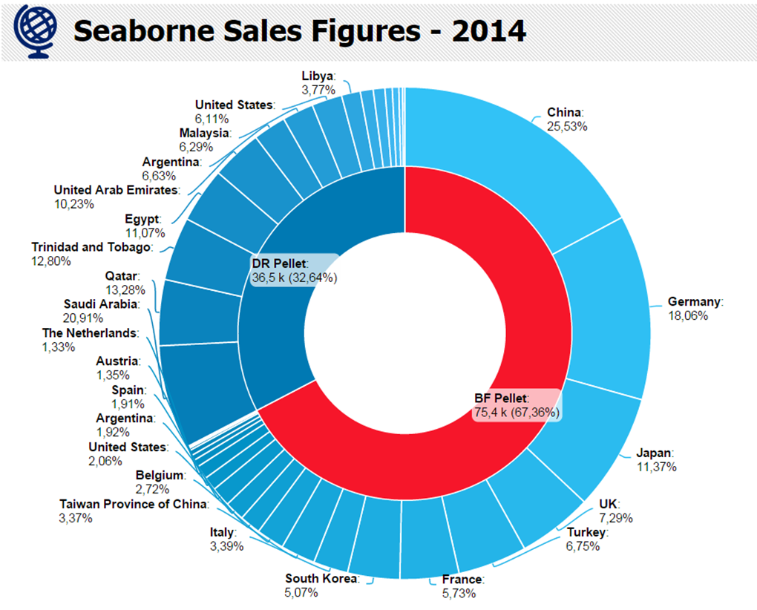
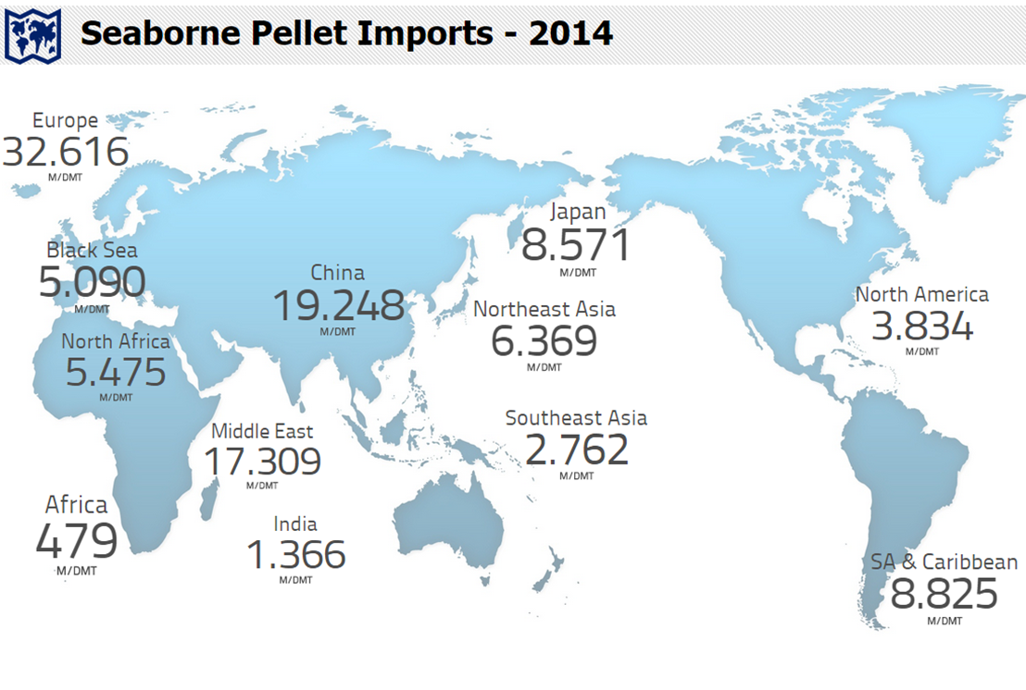
SAMARCO AND IRON ORE PELLET MARKET
2nd largest iron ore pellet supplier in seaborne market
114.8 M Ton

Slide 4
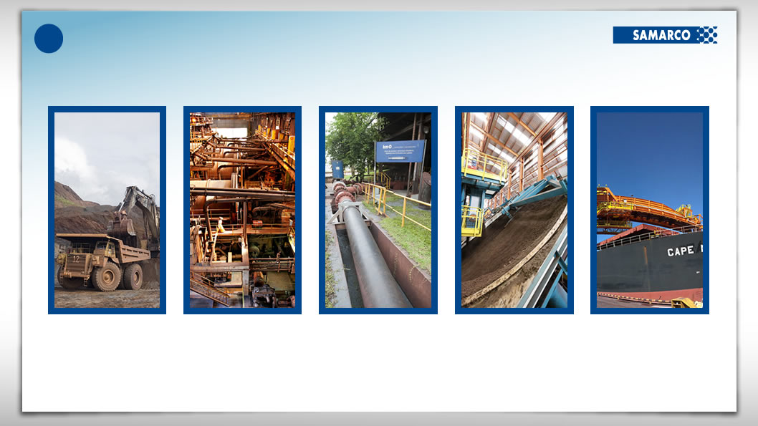
INNOVATION CHALLENGE IN SAMARCO
TO IMPLEMENT TECHNOLOGICAL SOLUTION FROM MINE TO PORT
A company where technology is applied intensively to optimize the use of natural resources and generating economic and social development, with respect for the environment.
Mining
Concentration
Pipeline
Pelletizing
Port
Iron Ore Concentrate
(67 – 68%%Fe)
Poor Iron Ore (45%Fe)
Iron Ore Pellets
(66 – 68%%Fe)

Slide 5
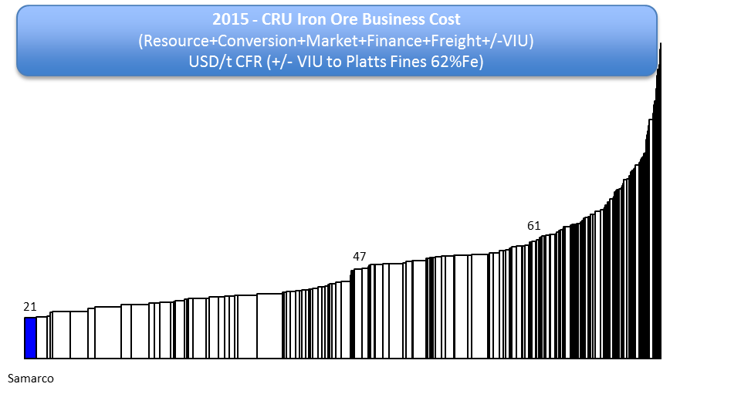
SAMARCO COMPETITIVENESS
one of the lowest operating costs COMPARED TO IRON ORE PRODUCERS
A company currently running at one of the lowest operating costs when compared to other iron ore producers due to:
optimized mining operations (open pit);
logistics advantages: pipelines system and own port terminal.
management highly focused on operating efficient;
technological innovative efforts.

Slide 6
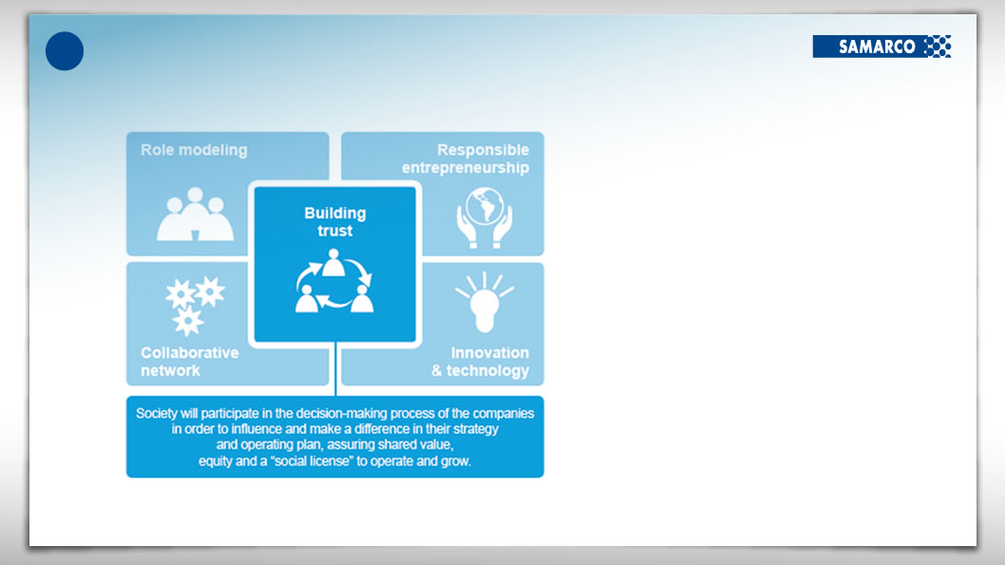
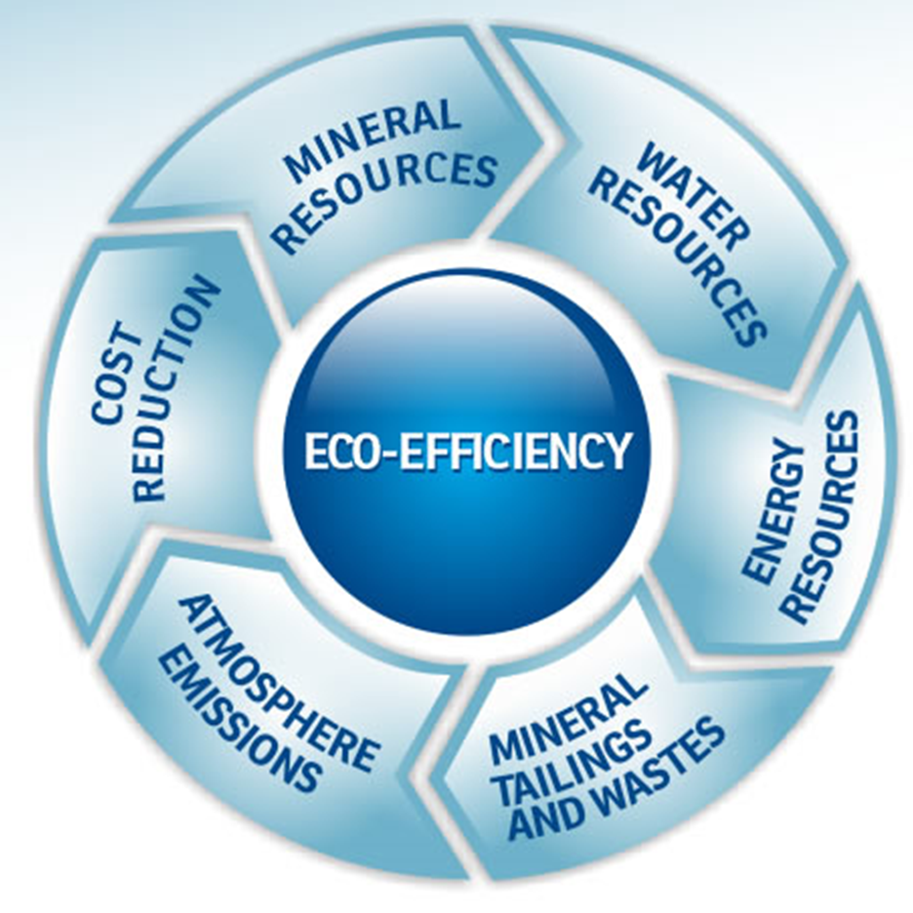
SAMARCO SUSTAINABILITY MODEL:
INNOVATION & TECHNOLOGY– AN IMPORTANT PILAR

Slide 7
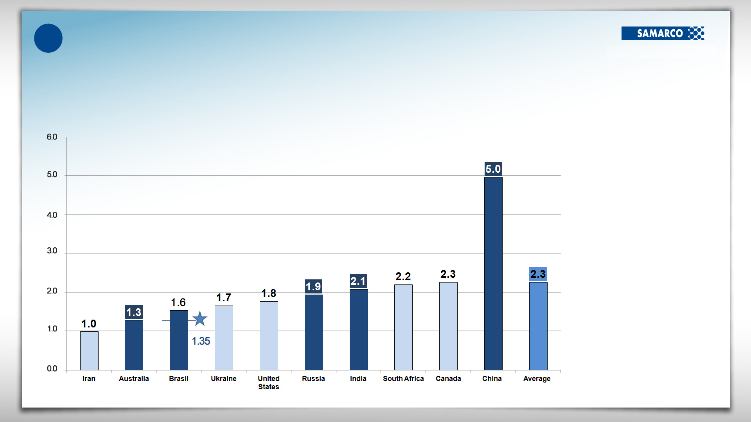
WATER RESOURCES AND MINING SECTOR
WATER SPECIFIC CONSUMPTION BY IRON ORE PRODUCER COUNTRY
IRON ORE
PRODUCTION (E)
WATER SPECIFIC CONSUMPTION (m³/ton IRON ORE)
TOP 5 IRON ORE PRODUCER COUNTRIES
> 100 million tons/year
< 100 million tons/year
SAMARCO
(with pipeline system)
Source: BI Samarco
Source: Adapted from Bluefield Research, CRU and Samarco

Slide 8
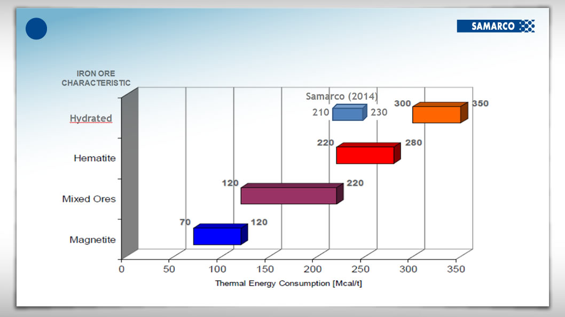
ENERGY EFFICIENCY AT PELLETIZING FURNACES
COMPARISON TO OTHER PELLETING OPERATIONS

Slide 9
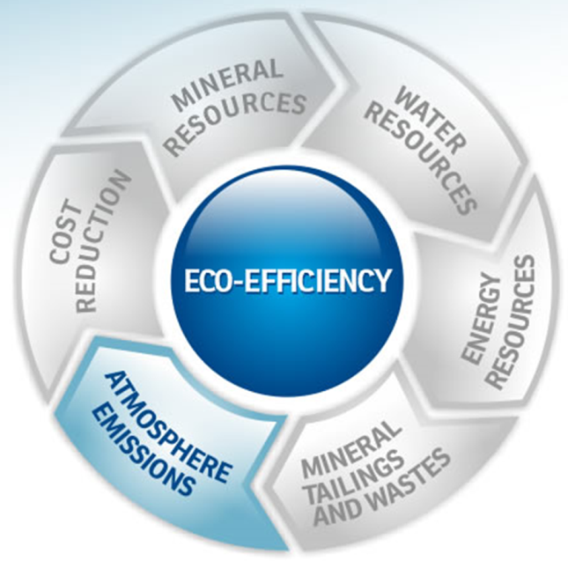
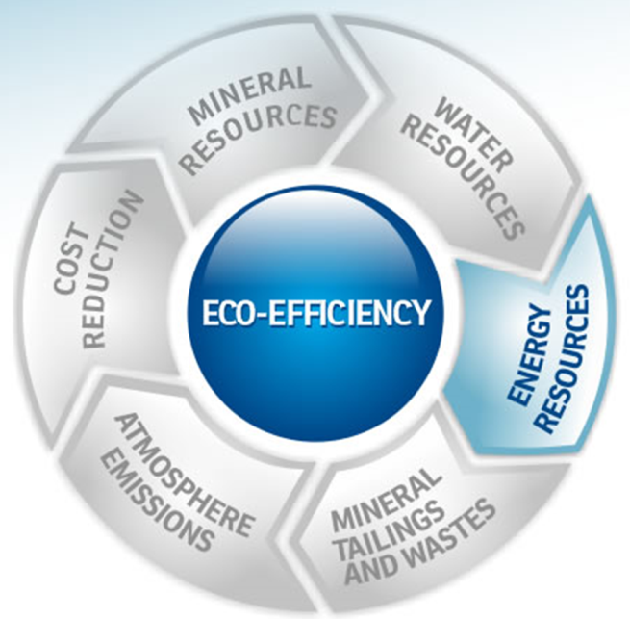

GHG EMISSION PERFORMANCE
CARBON INVENTORY
10 -15%
-55%
SOURCE: SAMARCO
MAIN ACTIONS:
2008: 3rd pellet plant startup ⬄ 2014: 4th pellet plant startup.
2010: Natural gas replacing heavy fuel oil;
Gains from LSS projects and other developments
SOURCE: IBRAM

Slide 10


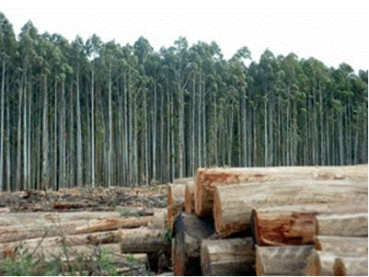
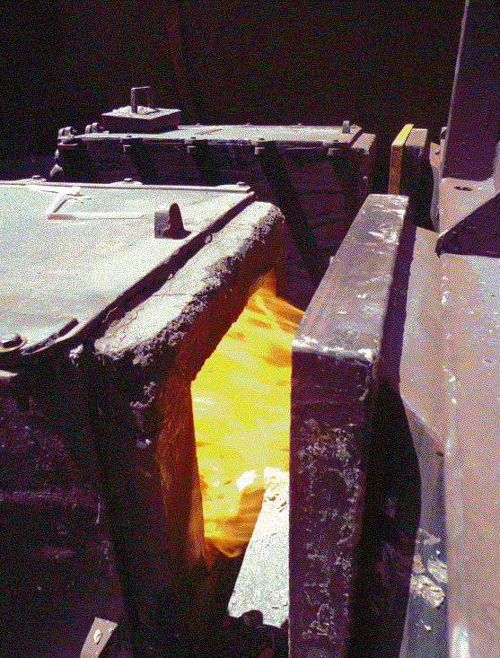
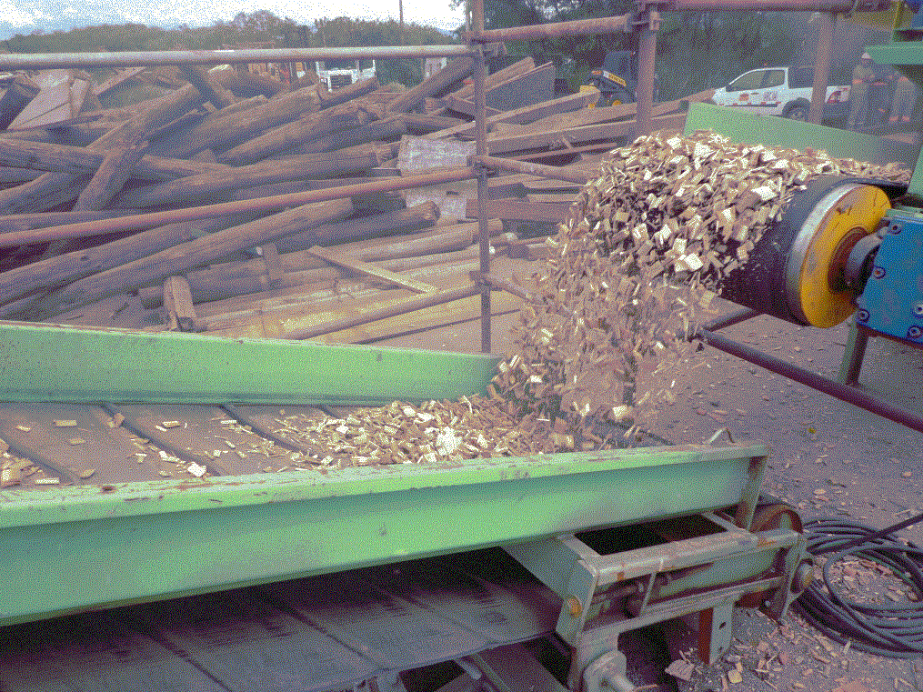
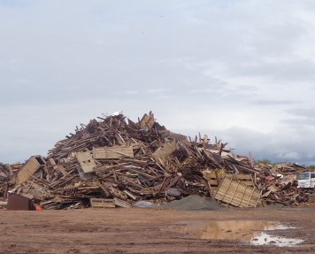

EXAMPLE OF TECHNOLOGICAL STUDIES IN PROGRESS
ALTERNATIVE RENEWABLE ENERGY GENERATION AND USAGE
Technological solution: Conversion of Biomass into Renewable Thermal Energy to Pelletizing Furnace
Where: pelletizing furnace replacing natural gas/heavy fuel oil and/or even ground antracite /pet coke added into green pellets.
Benefits:
Renewable energy utilization (even less GHG)
to provide a valuable destination any wood-based solid wastes;
Eucalyptus
PELLETING
FURNACE(S)
Other sort of biomass
Pre-processing
Heat Generation (Biocombustion)

Slide 11
QUESTIONS?

